Slide 1
Unit -1
IOT- AN ARCHITECTURAL OVERVIEW

Slide 2
OBJECTIVES
To understand the working of an IoT system and components
To get familiar with the building blocks and the architectural functioning mechanism of IoT.
To acquaint with the design principles and considerations when developing an IoT prototype

Slide 3
IOT definition:
The Internet of Things (IoT) describes the network of physical objects—“things”—that are embedded with sensors, software, and other technologies for the purpose of connecting and exchanging data with other devices and systems over the internet.

Slide 4
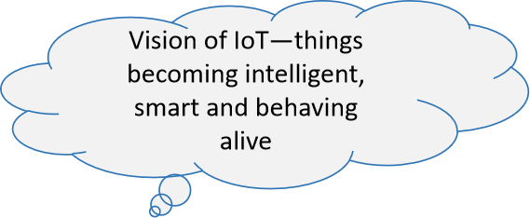
IoT Vision:
Internet of Things is a vision where things (wearable watches, alarm clocks, home devices, surrounding objects) become ‘smart’ and function like living entities by sensing, computing and communicating through embedded devices which interact with remote objects (servers, clouds, applications, services and processes) or persons through the Internet.

Slide 5
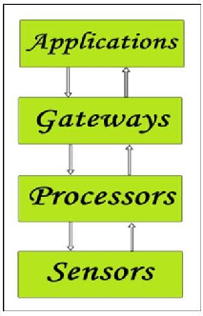
Building an architecture:
The IoT system's fundamental building parts include sensors, processors, gateways, and applications. To create a useful IoT system, each of these nodes must have unique properties.
Fig1: Simplified block diagram of the basic building blocks of the IoT

Slide 6
Sensors
They make up the IoT devices' front end.
Their primary function is to gather data from their environment (sensors) or to disseminate data to their environment (actuators).
To be easily recognized across a wide network, these must be uniquely recognizable devices having a unique IP address
They must be active, which means they must be able to gather data in real time. Depending on the user's demands, these can either function independently (autonomous in nature) or be modified to function independently (user-controlled).
Gas sensors, water quality sensors, moisture sensors, and other types of sensors are examples.

Slide 7
Processors
The IoT system's brain is its processor. Their primary duty is to process the information obtained by the sensors and separate the useful information from the vast amounts of raw information gathered. In a single sentence, we may claim that it offers the data intelligence.
Most processors operate in real-time and are simple for programs to regulate. They are also in charge of encrypting and decrypting data in order to secure the data.
Because they have processors attached to them, embedded hardware devices, microcontrollers, etc., are the ones that process the data.

Slide 8
Gateways
Gateways are in charge of sending the processed data to the appropriate areas for proper utilization.
In other words, we can say that a gateway facilitates the communication of data between two points. It gives the data network connectivity. Any IoT system must have network connectivity in order to interact.
Network gateways include LAN, WAN, PAN, etc.

Slide 9
Applications
Another component of an IoT system is applications. Apps are necessary for the effective use of all obtained data.
These cloud-based applications are in charge of giving the obtained data an effective meaning. Users control applications, which are used to deliver certain services.
Applications include things like security systems, industrial control hubs, and apps for home automation.

Slide 10
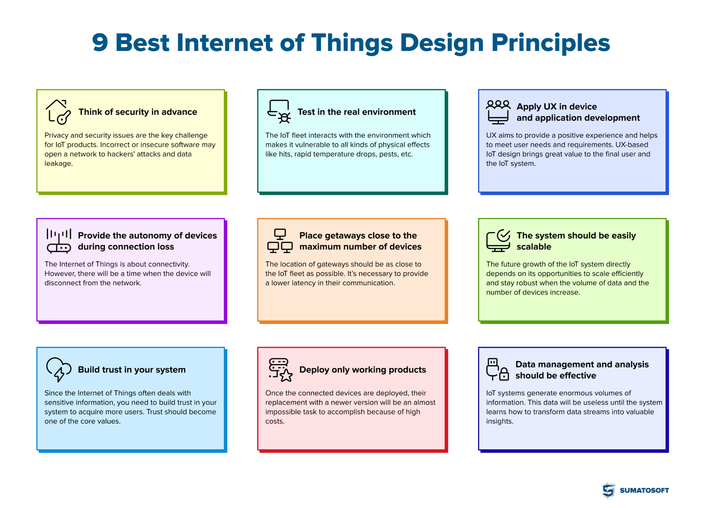
Main design principle of IoT architecture

Slide 11
A design principle means a guideline or rule that helps you build an effective, robust, and reliable IoT system.
Think of security in advance
Privacy and security issues are the key challenge for IoT products.
Incorrect or insecure software may open a network to hackers’ attacks and data leakage.
In addition, there is a need to establish proper security update processes as a part of IoT update management to deploy security patches effectively and quickly.
Test in the real environment
The IoT fleet interacts with the environment which makes it vulnerable to all kinds of physical effects like hits, rapid temperature drops etc.
All these treats are hard to test in laboratory conditions, so it’s necessary to test devices in a real environment where they are supposed to work further.

Slide 12
Apply UX in device and application development
UX aims to provide a positive experience and helps to meet user needs and requirements.
UX-based IoT design brings great value to the final user and the IoT system.
Provide the autonomy of devices during connection loss
The Internet of Things is about connectivity. However, there will be a time when the device will disconnect from the network.
The device should continue to work properly and transfer the collected information when the connection will be restored.

Slide 13
The system should be easily scalable
The future growth of the IoT system directly depends on its opportunities to scale efficiently and stay robust when the volume of data and the number of devices increase.
Build trust in your system
Since the Internet of Things often deals with sensitive information, you need to build trust in your system to acquire more users. Trust should become one of the core values.

Slide 14
Deploy only working products
Once the connected devices are deployed, their replacement with a newer version will be an almost impossible task to accomplish because of high costs.
That means that one single error in the fleet which is detected after the fleet deployment can lead to large financial losses. Due to that, it’s good to avoid untested hardware iterations and deploy only working products.
Data management and analysis should be effective
IoT systems generate enormous volumes of information. This data will be useless until the system learns how to transform data streams into valuable insights.
It is up to effective data management and analysis whether the IoT system will generate value or just become a data warehouse.

Slide 15
An IoT architecture outline
The complex arrangement of elements that make up IoT networking systems, including sensors, actuators, cloud services, protocols, and layers, is referred to as IoT architecture.
Different layers of IoT architecture
Depending on the particular business job at hand, different architectural layers and levels of complexity are used. The most common and standard architecture is a four-layer one.

Slide 16
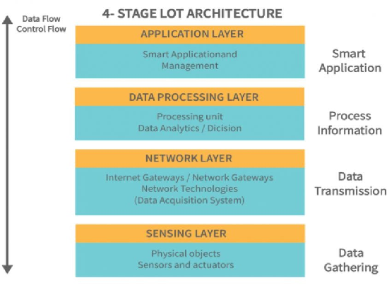
As you can see from the above image, there are four layers present i.e., the Perception Layer, Network Layer, Processing Layer, and Application Layer.

Slide 17
Perception/ Sensing layer:
Any IoT system's first layer is made up of "things" or endpoint devices that act as a link between the real world and the digital one.
The physical layer, which contains sensors and actuators capable of gathering, accepting, and processing data across a network, is referred to as perception.
Wireless or wired connections can be used to connect sensors and actuators. The components' range and locations are not constrained by the design.

Slide 18
Network layer
An overview of the data flow throughout the programme is given by the network layers. Data Acquisition Systems (DAS) and Internet/Network gateways are present in this tier.
Data aggregation and conversion tasks are carried out by a DAS (collecting and aggregating data from sensors, then converting analogue data to digital data, etc.).
Data gathered by the sensor devices must be transmitted and processed. The network layer performs that function.
It enables connections and communication between these gadgets and other servers, smart gadgets, and network gadgets. Also, it manages each device's data transmission.

Slide 19
Processing layer
The IoT ecosystem processing layer functions as its brain.
Before being transported to the data center, data is typically evaluated, pre- processed, and stored here.
It is then retrieved by software applications that handle the data and prepare future actions.
This is where edge analytics or edge IT comes into play.

Slide 20
Application layer
The application layer, which provides the user with application- specific services, is where user interaction occurs.
A dashboard that displays the status of the devices in a system or a smart home application where users may turn on a coffee maker by touching a button in an app are two examples.
The Internet of Things can be used in a variety of applications, including smart homes, smart cities, and smart health.

Slide 21
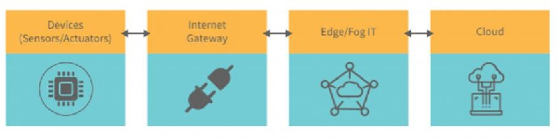
Stages of IoT solutions architecture
The various phases of IoT architecture implementation in businesses are as follows:

Slide 22
Connected objects/devices
The physical layer within the environment must be built as a first step towards IoT architecture. The Internet of Things would not exist without "smart" or linked objects.
On the perception layer, these are frequently wireless sensors or actuators.
Sensors gather and process environmental data to make it useful for additional research.
The change that the sensors register is measured by actuators.
Wired or wireless connections can be made between sensors and actuators to accomplish sensing and actuation. Sensors and actuators can be connected using Personal Area Networks (PANs) and Local Area Networks (LANs).

Slide 23
Internet gateway
After properly completing step one, the next task is to set up an internet gateway.
We need a way to convert analogue data that is being collected by the sensors and actuators into digital data so that we can process it.
The internet gateway is used to do this activity.
Before being transferred to the cloud, raw data from the devices will be received at the internet gateway stage and pre-processed.
Analog data can be transformed into digital data using data acquisition systems.

Slide 24
It establishes connections with the sensors and actuators, collects all the data, and transforms it into digital form so that the internet gateway may send it across the network.
It is in charge of conversion and data aggregation.
To improve performance and effectiveness, we can also add extra features like analytics and security.

Slide 25
Edge IT systems
Pre-processing and improved data analytics are part of the third stage of an IoT architecture.
Edge IT systems are essential in easing the burden on the main IT infrastructure due to the sizeable volume of data collected by IoT systems and the ensuing bandwidth requirements.
Machine learning and visualization techniques are used by edge IT systems to derive insights from gathered data.
While visualization tools make the data more comprehensible, machine learning algorithms offer insights into the data.
The system's speed, as well as the LAN or routers' bandwidth, would suffer if data is sent directly to the server or data center.

Slide 26
The system's speed, as well as the LAN or routers' bandwidth, would suffer if data is sent directly to the server or data center.
Analog data is produced very quickly and takes up a lot of storage space. As a result, it is always advised to convert data to digital format.
Only the necessary data is processed and communicated to data centers and servers because the majority of the data acquired by sensors and actuators is not valuable to the enterprise.

Slide 27
Data centers and cloud storage
The data is delivered to the data centers and servers for final analysis and reporting once it has been appropriately preprocessed, examined, and any gaps have been filled.
The management services area includes data centers and cloud services, which often handle data using analytics, device management, and security controls.
Data can also be transferred to end-user applications like healthcare, retail, environment, emergency, energy, etc. thanks to the cloud.

Slide 28
Standards Considerations
There are few considerations to make while creating the Internet of Things device:
Cost
Network
Features
User interface
Power
Size
Cloud
Interoperability
Security

Slide 29
1.Cost
IoT or "smart" products benefit producers and customers equally, although they are more expensive.
2.Network
The network technology you choose for your IoT product has concerns with gateways and routers as well as distance. Ethernet/Wi- Fi is required if you need to connect to the Internet; ZigBee, Z-Wave, and Bluetooth are available if you are self-contained in a room or building.

Slide 30
3.Features
Businesses may now add features to their products that were either impossible or unimaginable without an IoT-connected product. For updates, maintenance, and new revenue opportunities, you can obtain direct access to the consumer with the help of these capabilities.
4.User interface
It matters how a user interacts with a product. On the product, are you intending to use buttons, LEDs, or a display? What web and app interfaces will you offer as well?
5.Power
The choice of a power source should be among the first. All design choices must take power conservation into account if the item will be battery-powered. Many networking technologies won't operate well on batteries. Power selection is also influenced by communication frequency.

Slide 31
6.Size
Size does matter. Think about how the size of the device will be affected by the network. Certain networks' requirements for connectors and antennae will increase the size.
9. Interoperability
The ability of different IoT devices, platforms, or systems (made by different manufacturers) to work together and understand each other.
10. Security
You must incorporate as many layers of security as you can because security is starting to become a serious concern. The bare minimum is SSL and a password.

Slide 32
M2M and IoT Technology Fundamentals

Slide 33
Devices and gateways:
A device is a hardware unit that can sense aspects of it’s environment and/or actuate, i.e. perform tasks in its environment.
A device can have several properties, including:
Microcontroller: 8-, 16-, or 32-bit working memory and storage.
Power Source: Fixed, battery, energy harvesting, or hybrid.
Sensors and Actuators: Onboard sensors and actuators, or circuitry that allows them to be connected, sampled, conditioned, and controlled.
Communication: wireless or wired communication.
Applications: Simple sensor sampling or more advanced applications.
User Interface: Display, buttons, or other functions for user interaction.

Slide 34
Device types
There are no clear criteria today for categorizing devices, but instead there is more of a sliding scale. we group devices into two categories.
• Basic Devices:
Devices that only provide the basic services of sensor readings and/or actuation tasks, and in some cases limited support for user interaction.
These are devices that focus on providing essential functions like reading data from sensors or performing simple actions like turning on/off based on conditions. They might have basic ways for users to interact, such as buttons or simple displays.
For communication, they can connect to a local network (LAN) either through wired (like Ethernet) or wireless (like Wi-Fi) technology.

Slide 35
Basic devices
These devices are often intended for a single purpose, such as measuring air pressure or closing a valve. In some cases several functions are deployed on the same device, such as monitoring humidity, temperature, and light level.
The requirements on hardware are low, both in terms of processing power and memory.
The main focus is on keeping the bill of materials (BOM) as low as possible by using inexpensive microcontrollers with built-in memory and storage.
Another common goal is to enable battery as a power source, with a lifespan of a year and upwards by using ultra-low energy microcontrollers.

Slide 36
Advanced Devices:
These devices go beyond basic functions.
They not only read sensor data and perform actions but also handle more complex tasks.
They often have built-in capabilities to connect directly to the internet (WAN) without needing an external gateway.
They can save power smartly.
They handle multiple tasks.
A powerful CPU or microcontroller with enough memory and storage to host advanced applications.
A more advanced user interface with, for example, display and advanced user input in the form of a keypad or touch screen.

Slide 37
Gateways
A gateway in the context of networking and devices refers to a device that acts as a bridge between different networks or protocols.
Gateway Defined:
Network Bridge: A gateway connects two different networks that use different protocols. For example, it could connect a local area network (LAN) using Ethernet to the wider internet using a different protocol like TCP/IP.
Protocol Converter: It translates data between different types of networks or protocols, ensuring that devices on one network can communicate with devices on another network.

Slide 38
For very basic gateways, the hardware is typically focused on simplicity and low cost, but frequently the gateway device is also used for many other tasks, such as data management, device management, and local applications.
Data Management: Storing, filtering, or pre-processing the sensor data before sending it to the cloud.
Device Management: Keeping track of connected devices, checking their status, or updating their software.
Local Applications: Running small programs or logic locally—like turning on a fan when the temperature gets too high..

Slide 39
Device management
Device management (DM) is an essential part of the IoT and provides efficient means to perform many of the management tasks for devices:
Provisioning: Initialization (or activation) of devices in regards to configuration and features to be enabled.
Device Configuration: Management of device settings and parameters.
Software Upgrades: Installation of firmware, system software, and applications on the device.
Fault Management: Enables error reporting and access to device status.

Slide 40
Provisioning This is the initial setup or activation of a device when it is first connected to the network.
It involves assigning device IDs, registering devices with the management platform, and setting up initial configurations and security credentials.
Device Configuration
Once a device is provisioned and activated, it often requires ongoing management of its settings to ensure it operates as intended.
Device Configuration involves:
Adjusting or updating device parameters and settings remotely
Customizing device behavior based on user needs or environmental conditions

Slide 41
Software Upgrades Keeping devices’ software (firmware, system software, or applications) updated is critical for security, functionality, and performance.
DM allows remote installation of these updates without physically accessing the device.
Fault Management Devices can encounter errors or malfunctions. Fault management helps detect, report, and sometimes automatically fix these issues.
It includes monitoring device status, error logs, and alerts to maintain operational health.

Slide 42
Local and Wide Area Networking
Local Area Network (LAN):
Definition: A LAN is a network that connects computers and other devices within a limited area, such as a home, office, or campus.
Characteristics:
High-Speed Connectivity: Typically offers high-speed connections (e.g., Ethernet or Wi-Fi).
Limited Geographic Range: Covers a small geographic area.
Private Network: Usually confined to a single organization or home.
Usage: File sharing, printer access, and internal communications.

Slide 43
Wide Area Network (WAN):
Definition: A WAN spans a larger geographic area, connecting multiple LANs or other types of networks across cities, countries, or even continents.
Characteristics:
Varied Speed: Speeds can vary depending on the technology.
Large Geographic Range: Covers vast distances.
Public or Private: Can be either public (like the Internet) or private (e.g., a company's global network).
Usage: Interconnecting remote offices and global communication.

Slide 44
Data management
Data management in the Internet of Things (IoT) involves the collection, storage, processing, and analysis of data generated by IoT devices. This is crucial because IoT systems often produce vast amounts of data from different sources, including sensors, devices, and applications. Effective data management ensures that this data is utilized efficiently, securely, and in a manner that supports decision-making and operational efficiency.

Slide 45
1. Data Collection
Sensors: sensors will gather data from their environment or operations.
Data Sources: Data can come from various sources including environmental sensors, wearables, smart appliances, and industrial equipment.
2. Data Transmission
Communication Protocols: Data is transmitted from IoT devices to central systems or cloud platforms using various communication protocols.

Slide 46
Data Storage
Edge Storage: Some data is stored locally on edge devices to reduce latency and bandwidth usage.
Cloud Storage: Data is often sent to cloud-based storage solutions for scalability, backup, and more extensive processing.
Databases: Various types of databases are used, including relational databases (SQL) for structured data and NoSQL databases for unstructured or semi-structured data.

Slide 47
Data Processing
Real-Time Processing: Data can be processed in real-time at the edge or through streaming platforms to provide immediate insights and responses.
Batch Processing: Large volumes of data can be processed in batches for detailed analysis and reporting.
Data Analytics
Descriptive Analytics: Analyzing historical data to understand past behaviors and trends.
Predictive Analytics: Using statistical models and machine learning algorithms to predict future events or behaviors based on historical data.
Prescriptive Analytics: Providing actionable recommendations based on data analysis to optimize operations or decision-making.

Slide 48
6. Data Visualization
Dashboards: Creating visual dashboards to present data insights in an easily understandable format for stakeholders.
Reports: Generating detailed reports to communicate findings, trends, and actionable insights.
7. Data Security
Encryption: Securing data during transmission and storage using encryption protocols to prevent unauthorized access.
Access Control: Implementing robust authentication and authorization mechanisms to control who can access and manage data.

Slide 49
9. Data Privacy
Anonymization: Removing or obscuring personal identifiers from data to protect user privacy.
Data Retention Policies: Implementing policies on how long data is retained and ensuring it is disposed of securely when no longer needed.

Slide 50
Business processes in IoT.
Business processes in the Internet of Things (IoT) involve the integration of IoT technology into various organizational activities to improve efficiency, productivity, and decision-making.
Operational Efficiency
Automation: IoT enables automation of routine tasks by integrating devices that can perform actions based on data. For example, smart thermostats can adjust temperatures automatically, and smart lighting systems can turn on/off based on occupancy.
Predictive Maintenance: IoT devices can monitor equipment health and predict failures before they occur, allowing for timely maintenance and reducing downtime.

Slide 51
Supply Chain Management
Inventory Tracking: IoT sensors can track inventory levels in real-time, reducing the chances of overstocking or stockouts.
Logistics: IoT devices monitor the condition and location of goods in transit, improving supply chain transparency and reducing losses.
Cost Management
Operational Costs: By improving efficiency and automating processes, IoT can lead to significant cost savings in operations and maintenance.
Resource Optimization: IoT helps in better utilization of resources, which can lead to reduced operational expenses.
Efficiency: IoT solutions can monitor and control energy usage across facilities, optimizing energy consumption and reducing costs.

Slide 52
Product Development and Innovation
Feedback Loop: IoT devices provide continuous feedback on product performance and usage, informing improvements and new features.
Prototyping: Rapid prototyping and testing of IoT-enabled products can accelerate innovation and time-to-market.
Strategic Decision-Making
Insights: The data generated by IoT devices provides valuable insights that can drive strategic decisions and long-term planning.
Competitive Advantage: Businesses that leverage IoT effectively can gain a competitive edge through improved efficiency, customer experience, and innovation.

Slide 53
Remote Management
Security

Slide 54
Explain the key aspects of data management in the Internet of Things (IoT) framework.
Explain the 4 layer IoT architecture with a neat diagram.
Explain the main design principle of IoT architecture in detail.
What are the ten key considerations to keep in mind when creating an Internet of Things (IoT) device?
Explain the basic building blocks of an IoT architecture with a neat diagram.
Compare and contrast basic devices and advanced devices.
Explain the properties of devices with examples.
What is Device Management in IoT? Explain its main functions – provisioning, device configuration, software upgrades, and fault management.
Write a note on LAN and WAN.(5M)
Define a device in the context of IoT and explain any four of its properties.(5M)
List and explain the characteristics of basic devices in detail.(5M)

Slide 55
Explain the IoT world forum reference model with a neat diagram.
What are the primary technical design constraints in IoT systems, and how do they impact the development and implementation of these systems?
Explain the communication and service functional group in an IoT functional view with a neat diagram.
Write a note on i) Process management functional group ii) Service organization functional group.
Explain the components of IoT information view with suitable examples.
Describe how Power BI works and briefly explain its key components.
Describe the different IoT information handling mechanisms in detail.
Explain the functional view with a neat diagram.
Explain the Information View in IoT. Discuss the types of information handled in an IoT system and the ways this information is processed and managed.
Compare and contrast the Subscribe/Notify model with the Publish/Subscribe model in Information View. (5M)
Explain the following in detail:
i) IoT service FG
ii) Virtual entity FG
iii) Process Management FG
iv) Security FG
v) Management FG

